Slide 1

CS 4710 Database Systems
Farhan Tanvir
Lecturer, Department of Computer Science

Slide 2

Professional Background
PhD in Computer Science, Oklahoma State University
3 years of industry experience
Research Areas:
Graph Mining, Graph Neural Network
Bioinformatics, Computational Biomedicine

Slide 3

Hobbies and Interests:
Playing ping pong
Following soccer, Formula 1
Explore new places
Watching movies and TV series
Reading

Slide 4

Farhan Tanvir
Address: 1 Park Place, Suite 717, Atlanta, GA 303032
Email: ftanvir@gsu.edu
Office Hours: TR 12:30-1:30 PM

Slide 5

Course Update
Textbook:
Database System Concepts, Abraham Silberschatz, Henry F. Korth, S. Sudarshan, 7th Edition, McGraw-Hill / ISBN 978-0078022159
TAs:
Snehitha Poranki (sporanki1@student.gsu.edu)

Slide 6
Teaching Philosophy
Class Engagement and Participation
Careful Course Preparation

Slide 7

Zybook
In this course, we will use zybooks, which is an online textbook and assignment system. Most of the assignments will be covered through zybooks, so it is required to subscribe on zybooks. It will provide hands-on experience with SQL queries. The following steps is to be followed for completing the registration:
Sign in or create an account at learn.zybooks.com
Subscription code: GSUCSC47106710DSCI4710TanvirSpring2026
Subscribe : Subscription is ~$75.

Slide 8
Course Overview
Project-intensive course
Project contributes 35% of the entire grade

Slide 9

Course Update
Project Stage 1 due on Jan 26
https://docs.google.com/spreadsheets/d/1lz3QtIXF8eUfiQyXEqasHjiLjBd-bscamVAJj00cBhg/edit?gid=0#gid=0
Course Calendar
https://docs.google.com/spreadsheets/d/1QEXtib2QHE9eCnLVg2DY2obcndftr54ly-EiPqGJQNk/edit?gid=0#gid=0

Slide 10











Have You Ever Wondered
How does the software know where each user left off?
How does the software know when my username and password are correct when I log in?
How is data maintained in a database?
How secure is my data?
What can be done to make a database system cost less and run faster?
How does a software application interact with the database?
[Ref: emoji by Ekarin Apirakthanakorn]

Slide 11
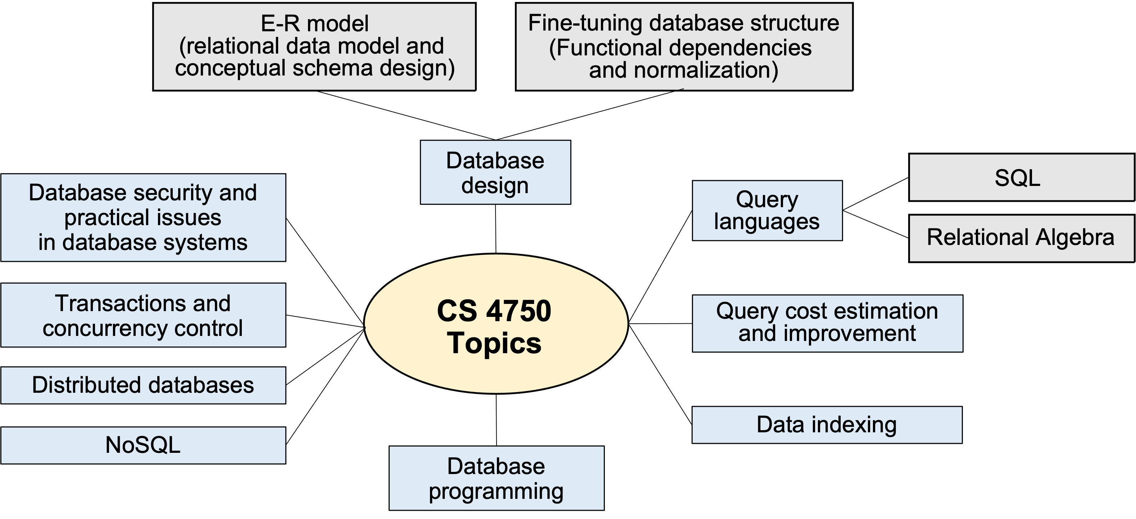


What This Course is About
Instead of designing any databases, we focus on how they should be design and create good databases
Implement a software utilizing databases to provide services

Slide 12
Focus / Not Focus
What we will focus / learn
Relational database
Focus on centralized, brief overview of distributed databases
Brief overview of semi-structured / NoSQL databases
Writing good queries that can lead to better performance
Designing and developing an effective and scalable database
Making use of a Database Management System (DBMS)
Integrating a database into a software
What we will not focus / learn
How to build a DBMS such as Oracle or SQL-database
How to write programs

Slide 13
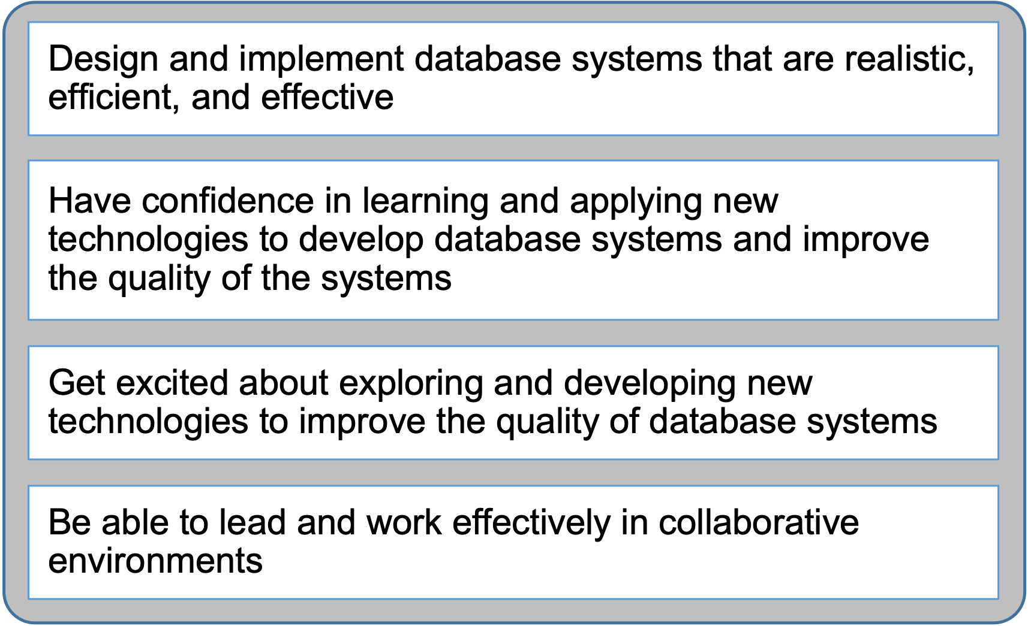
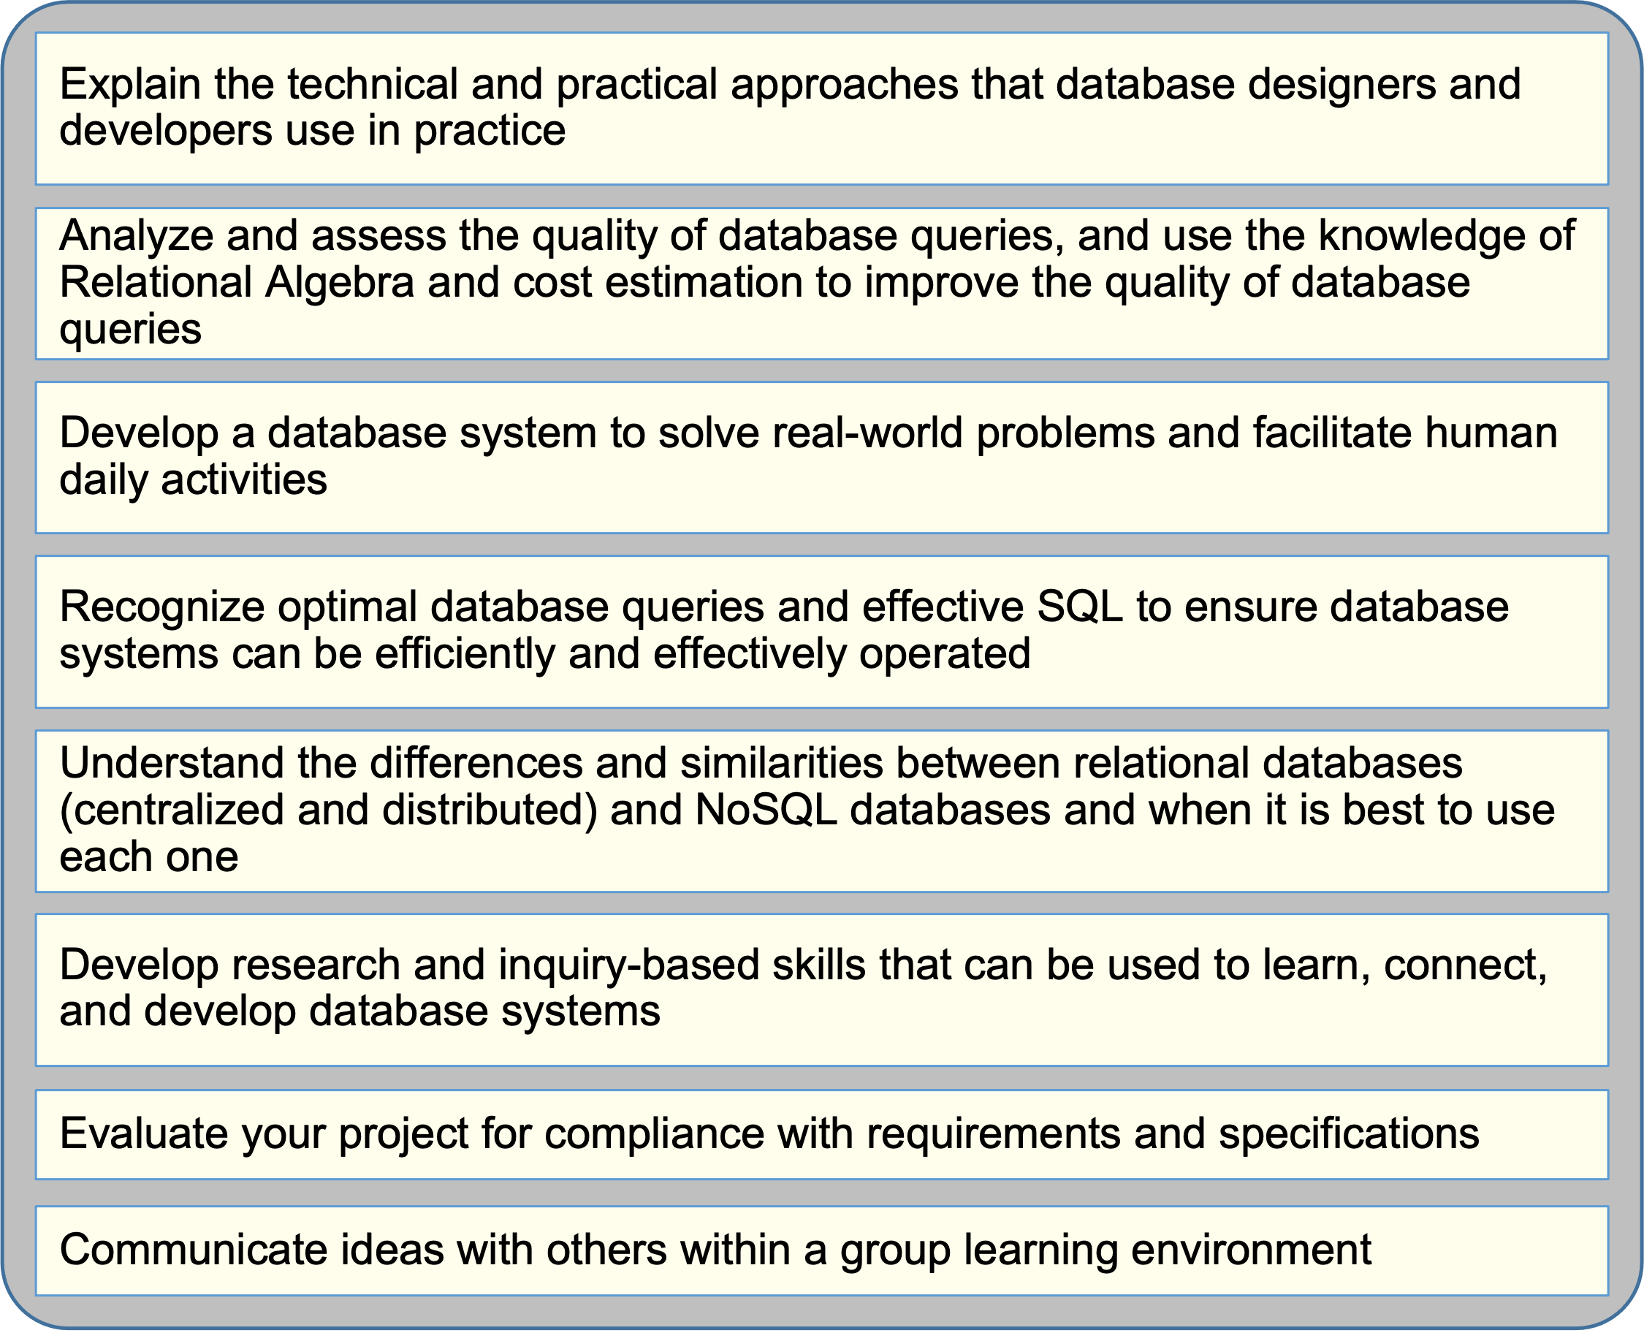
I Hope to Help You

Slide 14


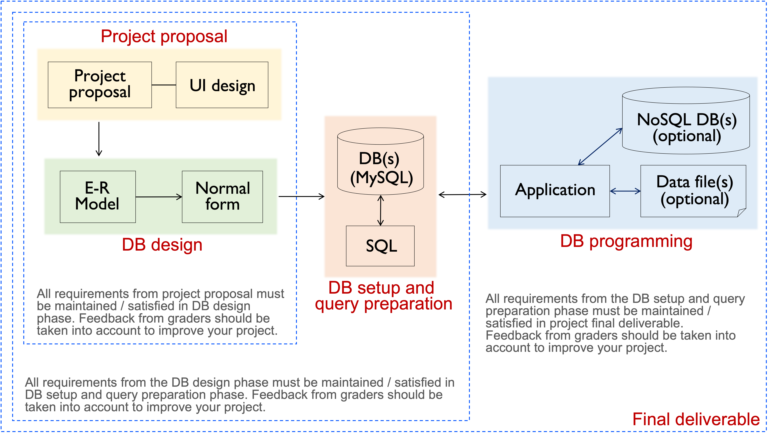

Project Overview
Optional: web service, web scraping,
Information visualization, asynchronous programming
This image shows the order and the specific concepts you will implement. It does not show the design
or architecture of the system. You may design your system as a web app or non-web app, using any
software architectural style(s) of your choice as long as a relational database is integrated into your app.

Slide 15

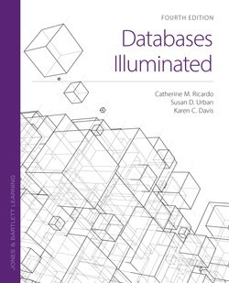
More Info to Help You Learn
Textbook: No text required, additional references will be provided
Style: In-person, Hands-on activities, lab-style work

Slide 16
Outline
Database vs. database Management System (DBMS)
Why use database and DBMS
Why learn about database and DBMS
Roles in DB environment
Common features of database system

Slide 17


Database
What is a database?
• Organized collection of related data
•Database may be as simple as a text file or a csv file or may be as complex as a large relational, integrated collection of data
Give examples of databases
• Bank account database; payroll database; UVA’s student
database; Amazon’s product database; Hotel reservation database; your notes for this class
Why do we need databases (in general)?
• Contain details about the organization or domain application
• Manage large amounts of data – deal with “big data”

Slide 18
Types of Databases
Operational databases Analytical databases
Collect, modify, maintain data
Store and track historical and time-dependent data
Backbone of companies
Store dynamic data (i.e., change constantly, reflect up- to-the-minute info)
Asset for tracking trends, viewing statistical data over a long period, making strategic business projections
Store static data (i.e., never or very rarely change, reflect a point-in-time snapshot of the data, not up to date)
Our focus

Slide 19


Needs for Data management
Data must be persistent.
However, data are large – can’t fit all in memory
Describe real-world entities in terms of stored data
Persist large datasets
Efficiently query and update data
Change structure of data stored (add, update, remove attributes)
Simultaneously updates
Recover from failures
Ensure security and integrity
Minimize redundancy
Why do we want to minimize redundancy in databases?
• Save space, save cost
• Avoid updating/deleting in multiple places -- consistency
• Prevent data from being corrupt

Slide 20
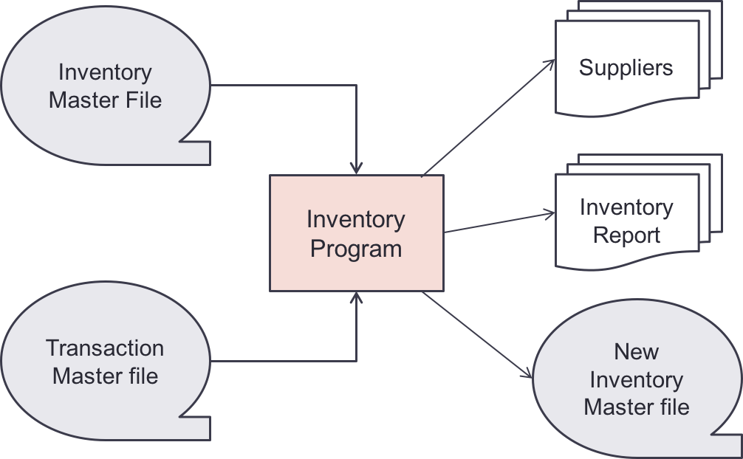
Early Attempt … to Relational Model
Rely on file systems
Programmers must visualize data much as they were stored
Use several different data models for describing the structure of information in a DB
…
Ted Codd introduced database systems based on ”relations”
[Codd, E.F., “A relational model for large shared data banks,” Comm. ACM, 13:6, pp. 377-387, 1970]

Slide 21


Database Management System
What is a DBMS?
Software to create, manage, maintain, persist databases over long periods of time
Manage: data, database engine, database schema
Allow data to be accessed, locked, and modified
Define the database’s logical structure
Provide concurrency, security, data integrity and uniform administration procedures
Examples:
MySQL, SQLite, MongoDB, PostgreSQL, Oracle, DB2, MS-SQL, Derby

Slide 22


DBMS Properties
Queryable: Provide a way to ask DB questions and retrieve data
Durable: Ensure the safety of information stored (data persists)
In-memory DB trade durability for speed?
Have schema: Define structure for storage of information
What about Semi-structured DB?
No redundancy: Reduce space
Indexes trade space for speed?
Difficult to achieve all
– balance and tradeoff
Optimizes queries: Make query run faster
What about complex queries? NoSQL DB has a “WYSIWYG” flavor
Handle concurrent transactions: Manage database engine
Turn off serialization for speed?

Slide 23
Key Roles in DB Environment
DB Administrator (DBA): load data, tune system, keep thing running
DB designers: specify structure (schema) of data to be stored
Application developers: write programs that access and manipulate data
Data analyst: clean and correct, mine, integrate data
DBMS implementer: build DBMS

Slide 24
Common Features / Key Concepts
Data models: how to describe real-world data
Schema: description of tables
Instance: snapshot of data stored in DB at a given time
Data Definition Language (DDL): effect schema
Data Manipulation language (DML): effect instance
Physical data independence: change how data are stored on disk w/o affecting apps
Logical data independence: change schema w/o affecting apps
Query processing and cost estimation: estimate cost of execution, choose the plan with the least estimated cost
Transactions: atomicity, consistency, isolation, and durability

